Slide 1


Benchmark Evaluation of Scale-Up and Scale-Out Techniques on a Functional Programming Based Microservice
Master Thesis
Politehnica University Timișoara
Supervisor:
Lect.dr.eng. Alexandru TOPÎRCEANU
CANDIDATE:
ARNOLD ATTILA HIGYED
TIMIȘOARA
JUNE 2020

Slide 2
Content
Introduction
About the microservice
Scaling
Scenarios
Results
Conclusions

Slide 3
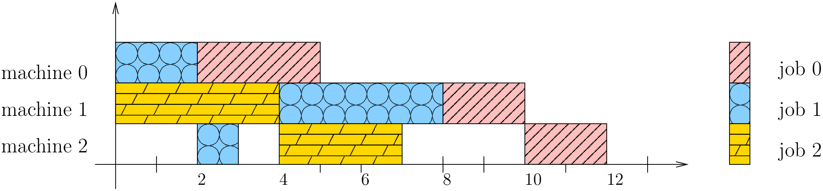
Introduction
What is measured?

Slide 4
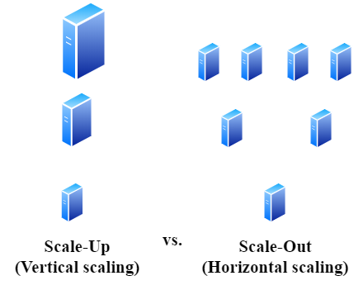
Introduction
How it is measured?

Slide 5
Introduction
Which scaling technique is better and more load-tolerant?
How do the two strategies perform together?

Slide 6
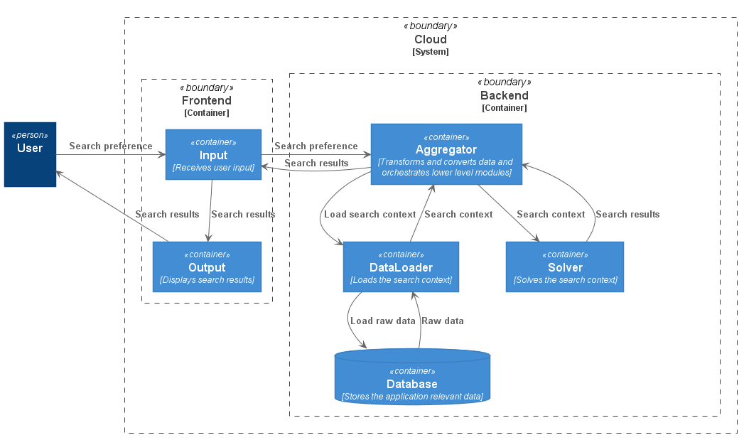
About the microservice
Planning application architecture

Slide 7
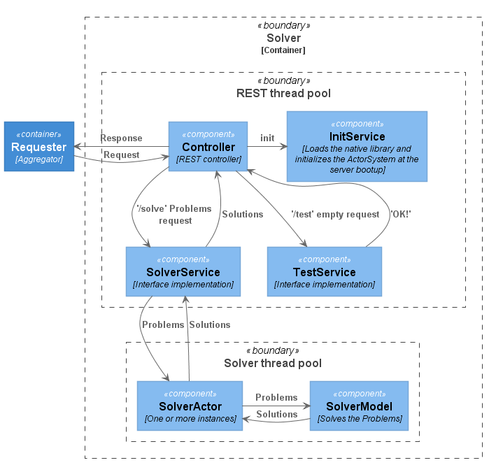
About the microservice
Solver architecture

Slide 8
About the microservice
Constraints programming
6 constraints: operationGrid, sameResource, enforceTimeInterval, operationsRelation, program and disjunctive
3 costs: asSoonAsPossible, asTightAsPossible, prefferedTimeInterval

Slide 9
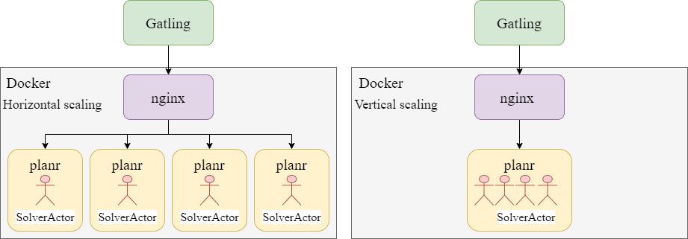
Scaling

Slide 10
Initial scaling scenarios
/ | C | Co/C | M/C (GB) | A/C | H/C (GB)
planr 4.0 | 1 | 8 | 8 | 4 | 2
planr 2.0 | 2 | 4 | 4 | 2 | 1
planr 1.0 | 4 | 2 | 2 | 1 | 0.5
(C – Container, Co – Core, M – Memory, A – Akka Actor/Thead, H – JVM Heap)

Slide 11
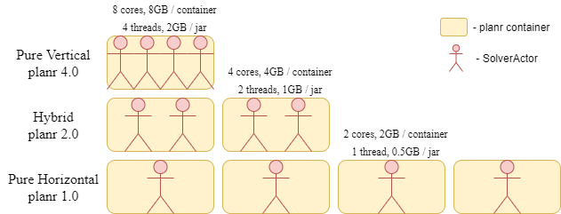
Initial scaling scenarios

Slide 12
Request scenarios
/ | R | P/R | S/R
Request 4.0 | 1 | 4 | 4
Request 2.0 | 2 | 2 | 2
Request 1.0 | 4 | 1 | 1
(R – POST request, P – Problem, S – Solution)

Slide 13
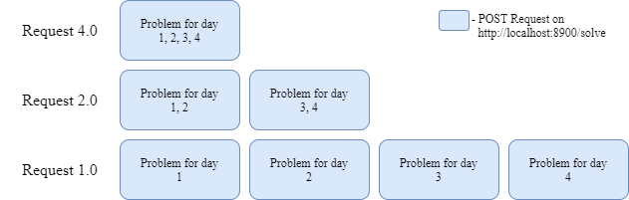
Request scenarios

Slide 14
Initial test scenarios
/ | planr 1.0 | planr 2.0 | planr 4.0
Scenario 1 | Request 1.0 | Request 2.0 | Request 4.0
Scenario 2 | Request 1.0 | Request 1.0 | Request 1.0
Scenario 3 | Request 4.0 | Request 4.0 | Request 4.0

Slide 15
Results
Scenario 1 (c)

Slide 16
Results
Scenario 2 (h)

Slide 17
Results
Scenario 3 (v)

Slide 18
Further scaling scenarios
/ | C | Co/C | M/C (GB) | A/C | H/C (GB)
planr 1.2 | 4 | 2 | 2 | 2 | 0.5
planr 1.4 | 4 | 2 | 2 | 4 | 0.5
planr 1.8 | 4 | 2 | 2 | 8 | 0.5
planr 1.16 | 4 | 2 | 2 | 16 | 0.5
(C – Container, Co – Core, M – Memory, A – Akka Actor/Thead, H – JVM Heap)

Slide 19
Further test scenarios
/ | planr 1.2 | planr 1.4 | planr 1.8 | planr 1.16
Scenario 4 | Request 1.0 | Request 1.0 | Request 1.0 | Request 1.0
Scenario 5 | Request 4.0 | Request 4.0 | Request 4.0 | Request 4.0

Slide 20
Results
Scenario 4 (h)

Slide 21
Results
Scenario 5 (v)

Slide 22
Conclusions
Pure horizontal scaling provides better performance than a pure vertical one
The combination of scale-out and scale-up techniques maximizes efficiency to cope with overload periods
Future work consists of defining the relation between the vertical scaling entities and physical resources

Slide 23
Thank you for your attention!

